Slide 1
Breast Cancer Diagnosis Classification Based on Machine Learning Algorithms
Tam Huynh
github.com/tamhuynh92/

Slide 2
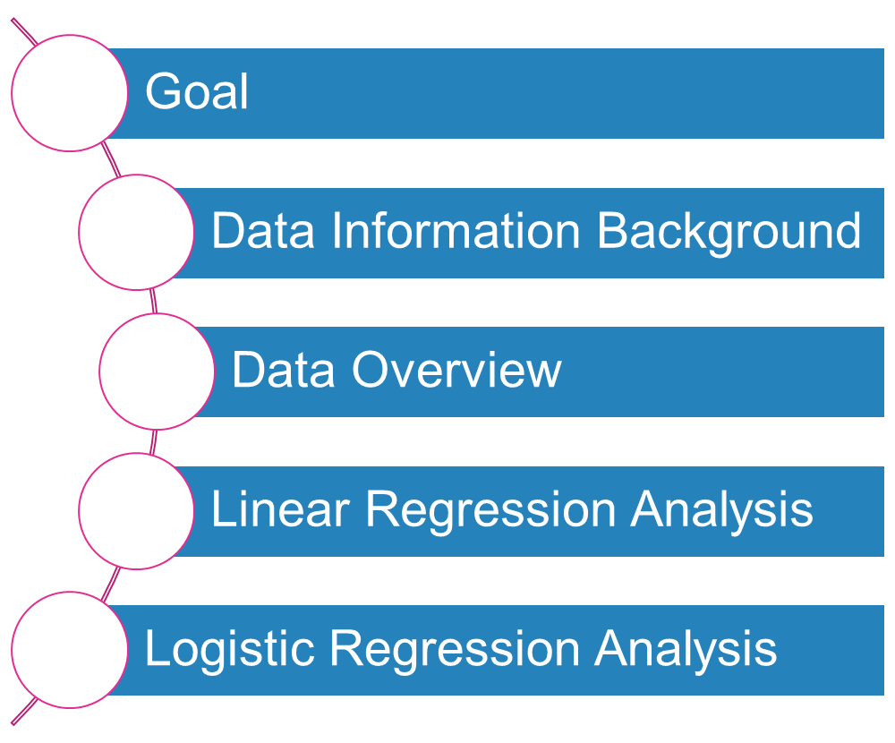
Outlines
github.com/tamhuynh92/

Slide 3
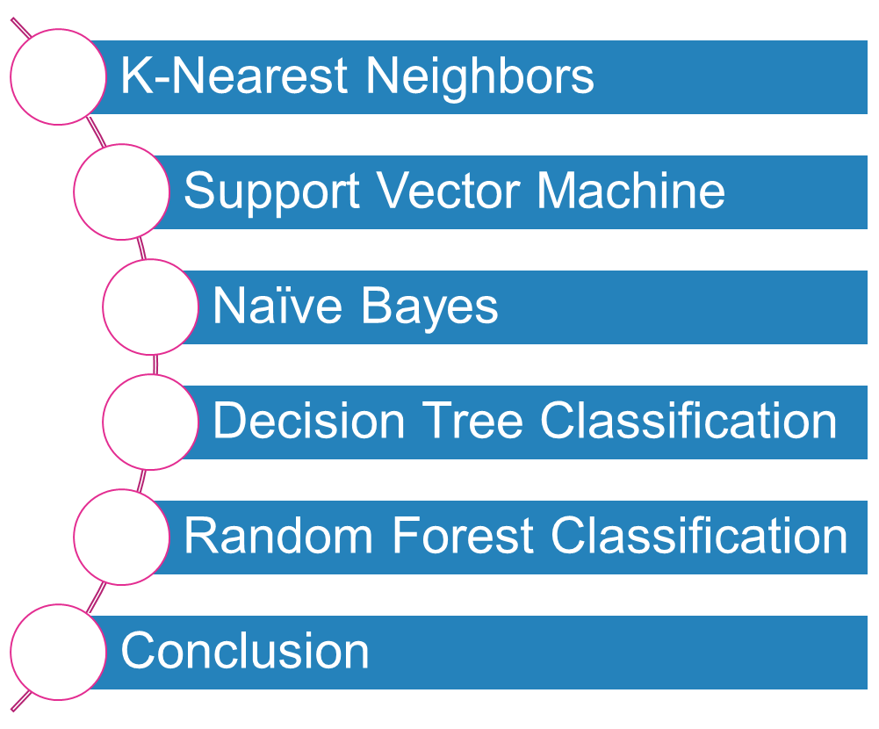
Outlines
github.com/tamhuynh92/

Slide 4
Goal
By using several supervised and unsupervised machine learning model, we can identify whether each breast cancer patient belong to benign or malignant group.
Data Obtain from:
https://www.kaggle.com/uciml/breast- cancer-wisconsin-data
github.com/tamhuynh92/

Slide 5
Data Information Background
Attribute Information:
  ID number
  Diagnosis (M = malignant, B = benign)
  Ten real-valued features are computed for each cell nucleus:
The mean, standard error and "worst" or largest (mean of the three largest values) of these features were computed for each image, resulting in 30 features. For instance, field 3 is Mean Radius, field 13 is Radius SE, field 23 is Worst Radius.
All feature values are recoded with four significant digits.
Missing attribute values: none
Class distribution: 357 benign, 212 malignant
github.com/tamhuynh92/

Slide 6
Data
    Radius (mean of distances from center to points on the perimeter)
    Texture (standard deviation of gray-scale values)
    Perimeter
    Area
    Smoothness (local variation in radius lengths)
    Compactness (perimeter^2 / area - 1.0)
    Concavity (severity of concave portions of the contour)
    Concave points (number of concave portions of the contour)
    Symmetry
    Fractal dimension ("coastline approximation" - 1)
github.com/tamhuynh92/

Slide 7
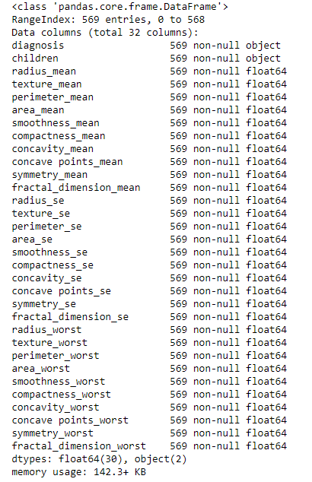
Data
Use these data to predict
the diagnosis
github.com/tamhuynh92/

Slide 8
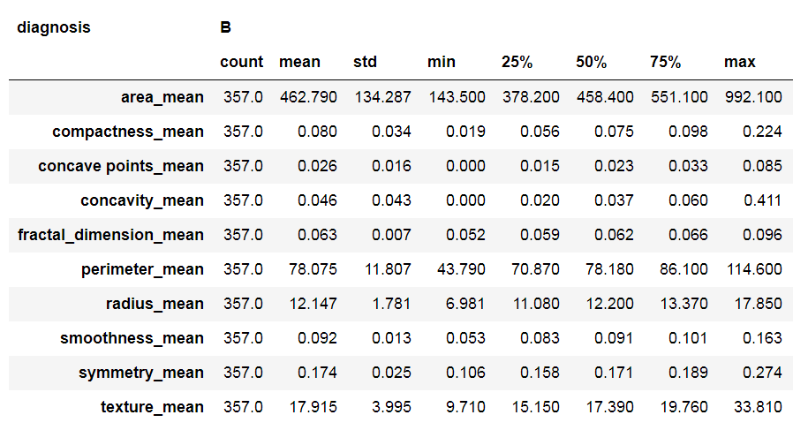
Summary Data
Benign Diagnosis
github.com/tamhuynh92/

Slide 9
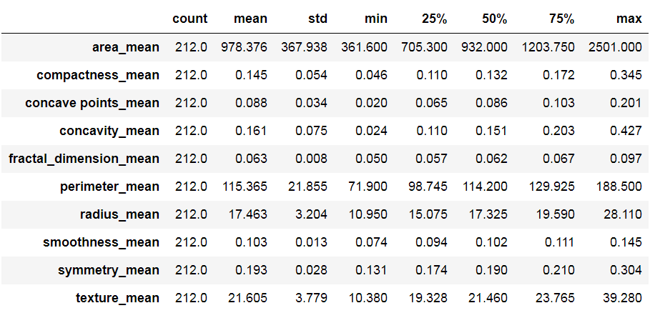
Summary Data
Malignant Diagnosis
github.com/tamhuynh92/

Slide 10
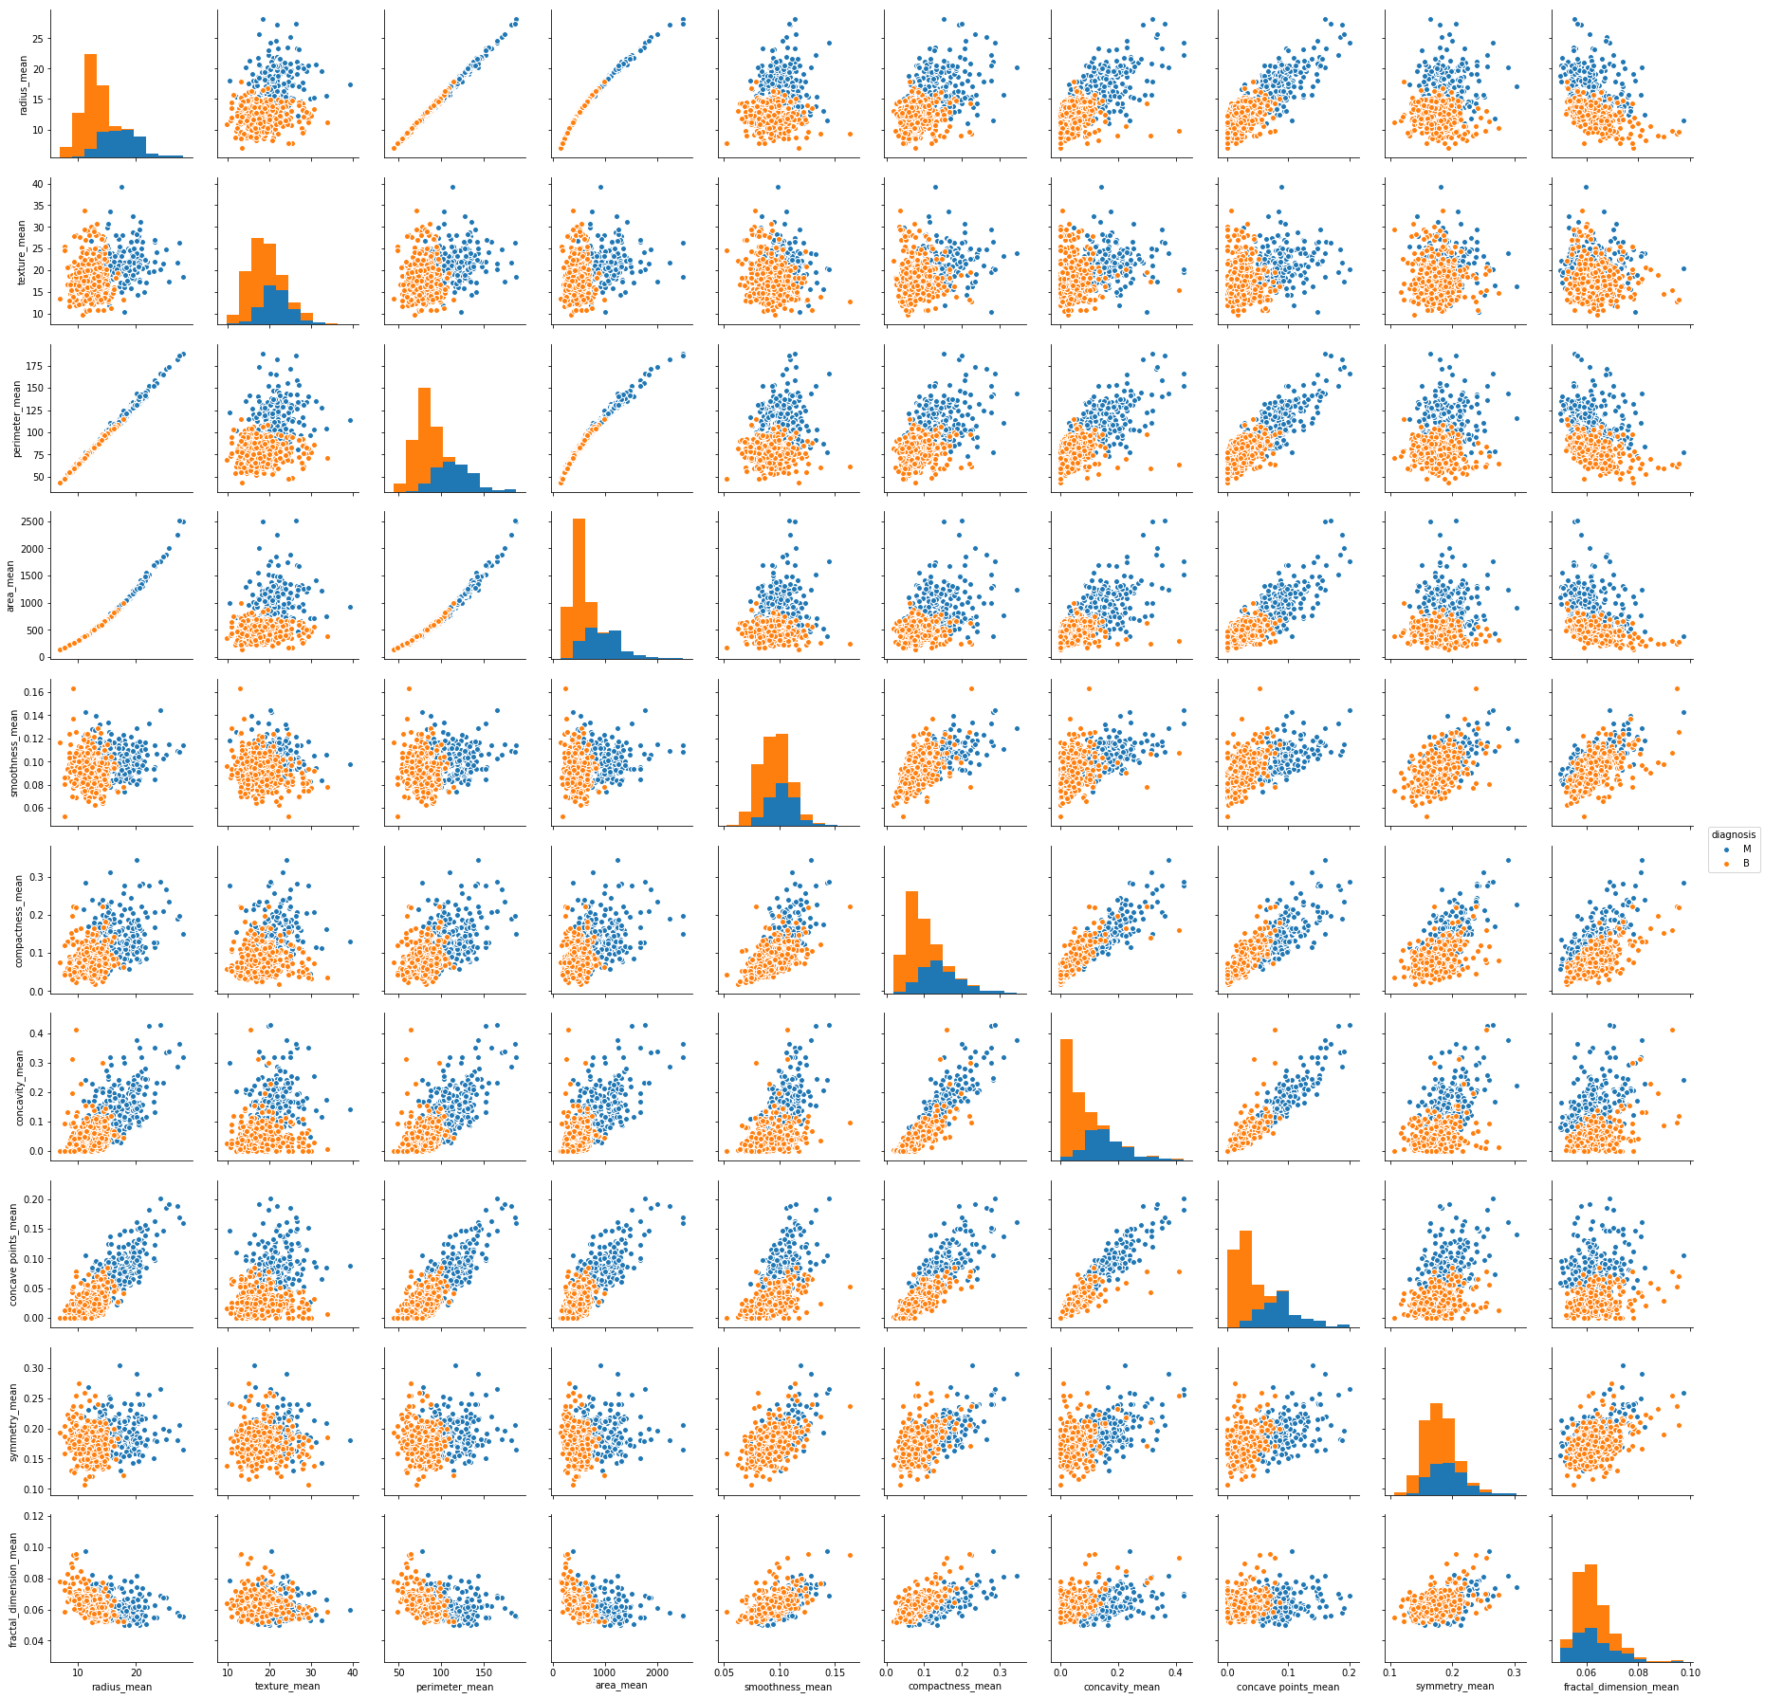
Summary Data
github.com/tamhuynh92/

Slide 11
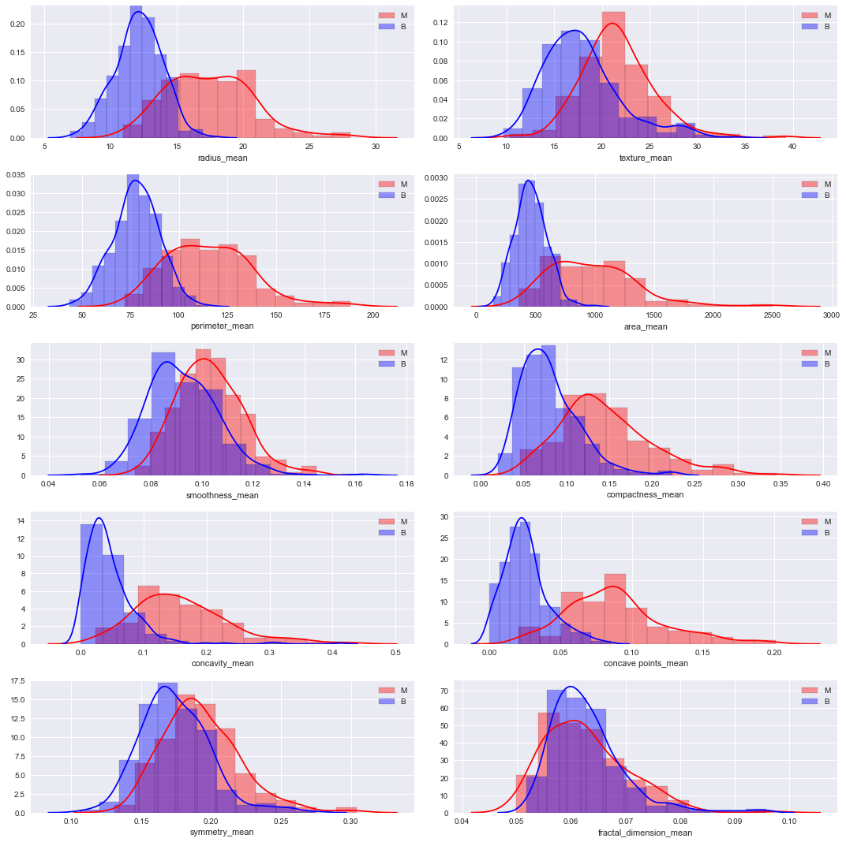
github.com/tamhuynh92/

Slide 12
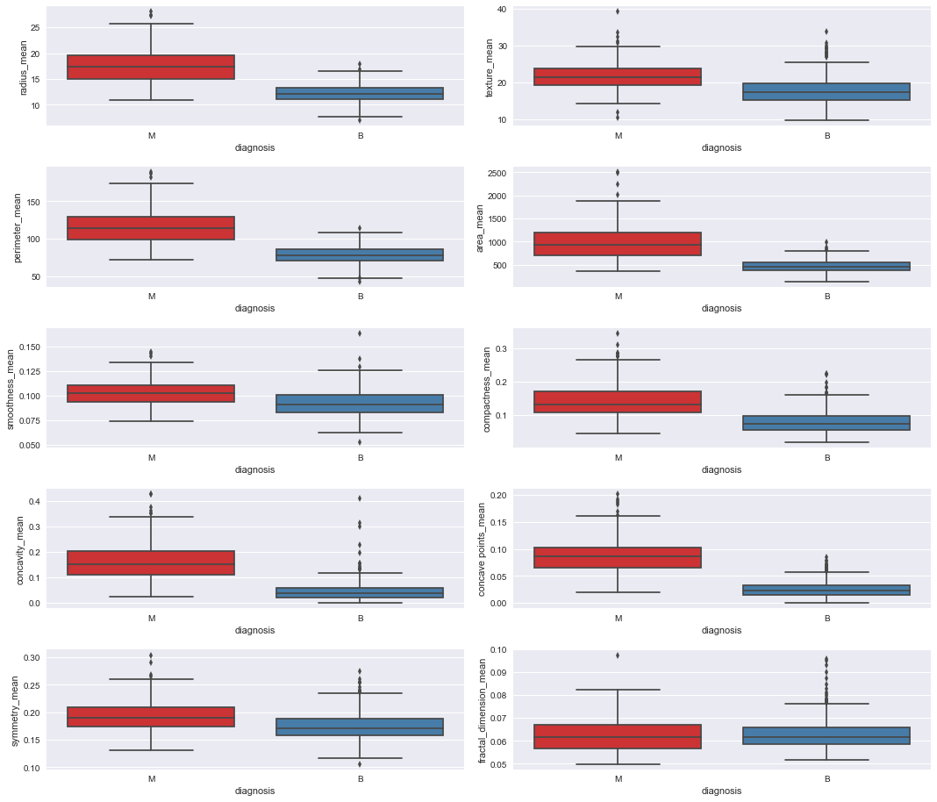
github.com/tamhuynh92/

Slide 13
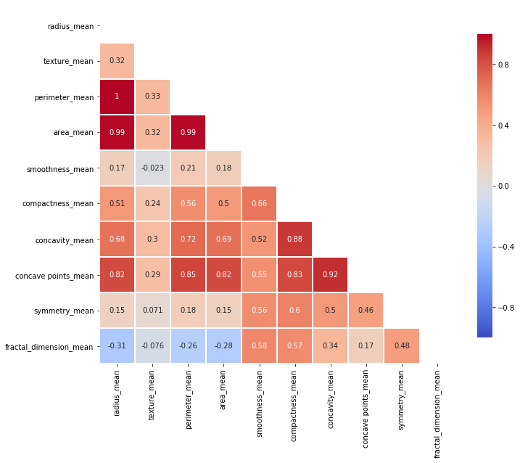
Linear Regression Analysis
Correlation Heat Map
github.com/tamhuynh92/

Slide 14
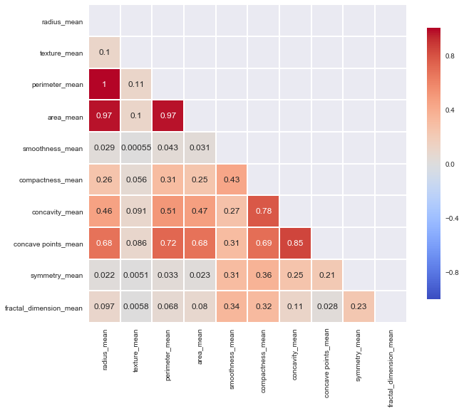
Linear Regression Analysis
R-squared Heat Map
github.com/tamhuynh92/

Slide 15
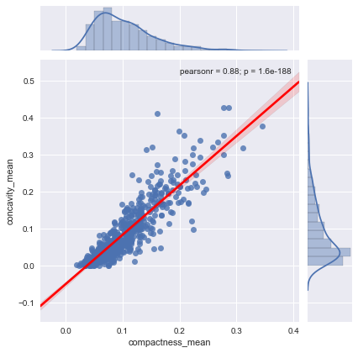
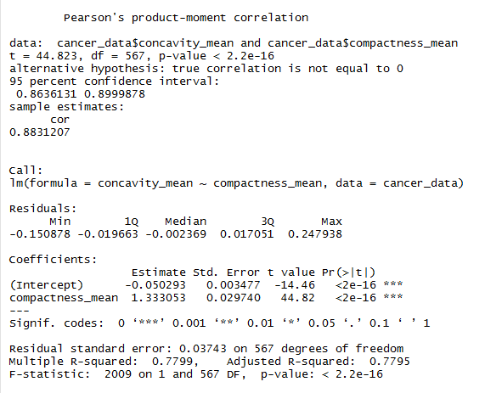
Linear Regression Analysis
Concavity_mean vs. Compactness_mean
github.com/tamhuynh92/

Slide 16
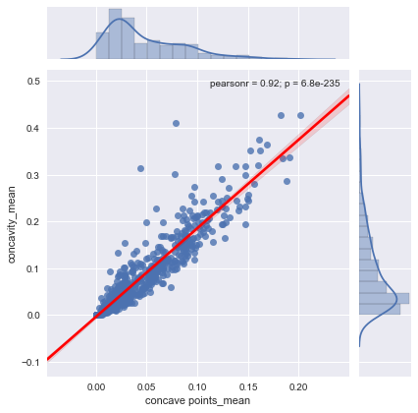
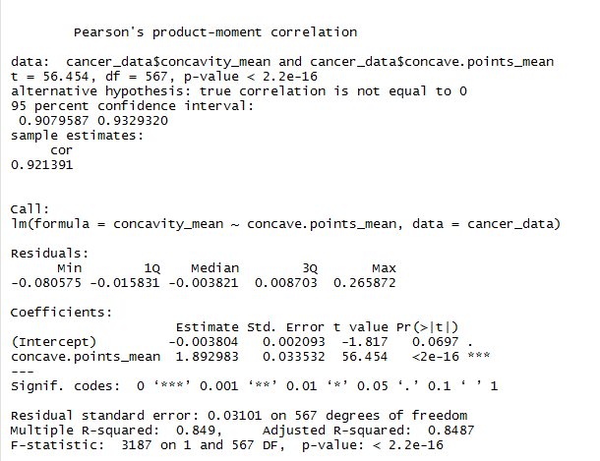
Linear Regression Analysis
Concavity_mean vs. Concave points_mean
github.com/tamhuynh92/

Slide 17
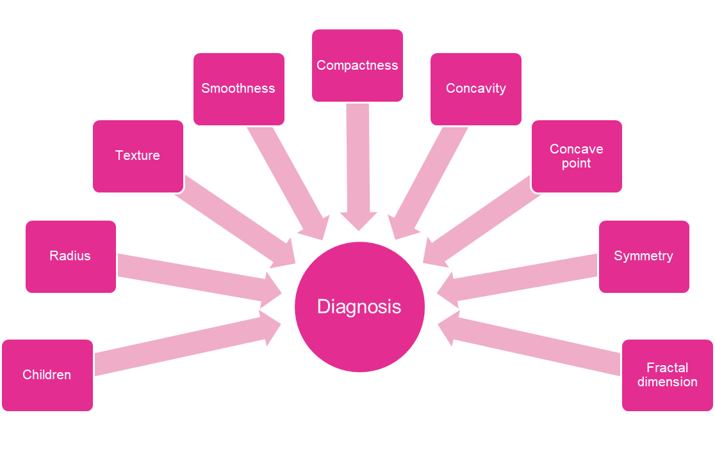
Prediction Model Analysis
github.com/tamhuynh92/

Slide 18
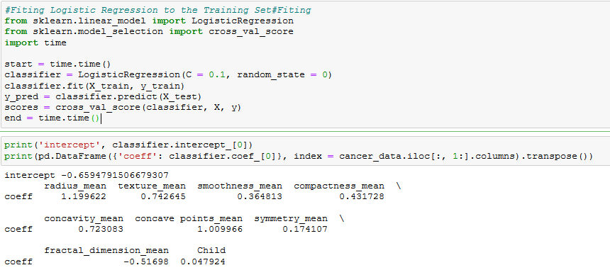
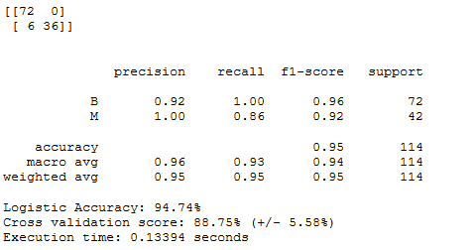
Logistic Regression Analysis
github.com/tamhuynh92/

Slide 19
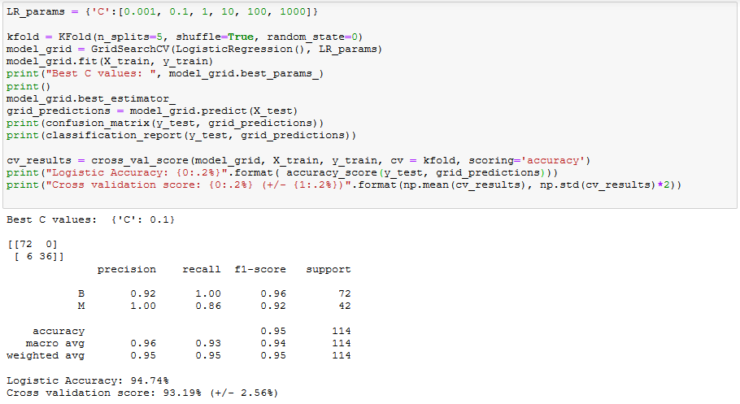
Logistic Regression Optimization
github.com/tamhuynh92/
Notes:
Advantages
Because of its efficient and straightforward nature, doesn't require high computation power, easy to implement, easily interpretable, used widely by data analyst and scientist. Also, it doesn't require scaling of features. Logistic regression provides a probability score for observations.
Disadvantages
Logistic regression is not able to handle a large number of categorical features/variables. It is vulnerable to overfitting. Also, can't solve the non-linear problem with the logistic regression that is why it requires a transformation of non-linear features. Logistic regression will not perform well with independent variables that are not correlated to the target variable and are very similar or correlated to each other.

Slide 20
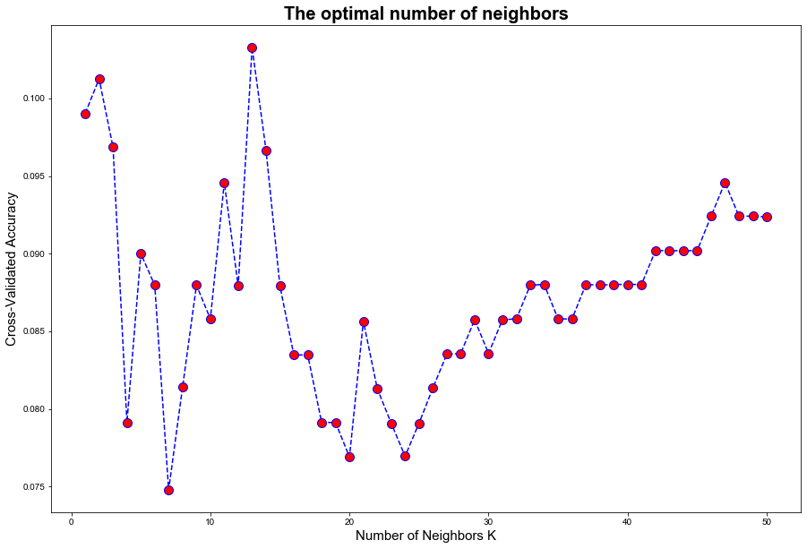
K-Nearest Neighbors Analysis
github.com/tamhuynh92/
Notes:
as k increases
•we are averaging over more neighbors
•the effective decision boundary is more “smooth”
–as N increases, the optimal k value tends to increase
–k=1, m increasing to infinity : error < 2x optimal
The advantage of choosing k > 1 is that higher values of k provide smoothing that reduces the risk of overfitting due to noise in the training data. Generally speaking, if k is too low, we may be fitting to the noise in the data. However, if k is too high, we will miss out on the method’s ability to capture the local structure in the data, one of its main advantages.
Some pros and cons of KNN
Pros:
No assumptions about data — useful, for example, for nonlinear data
Simple algorithm — to explain and understand/interpret
High accuracy (relatively) — it is pretty high but not competitive in comparison to better supervised learning models
Versatile — useful for classification or regression
Cons:
Computationally expensive — because the algorithm stores all of the training data
High memory requirement
Stores all (or almost all) of the training data
Prediction stage might be slow (with big N)
Sensitive to irrelevant features and the scale of the data

Slide 21
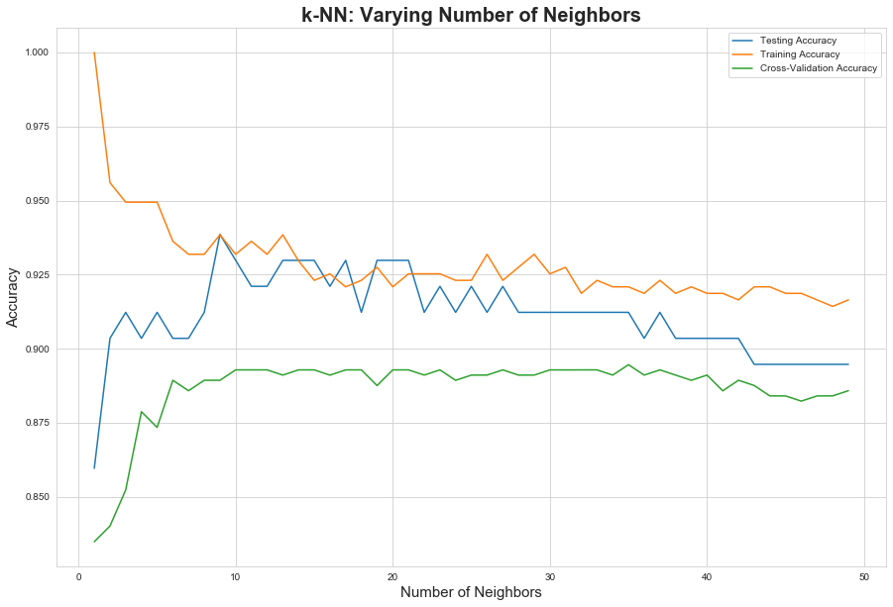
K-Nearest Neighbors Analysis
github.com/tamhuynh92/

Slide 22
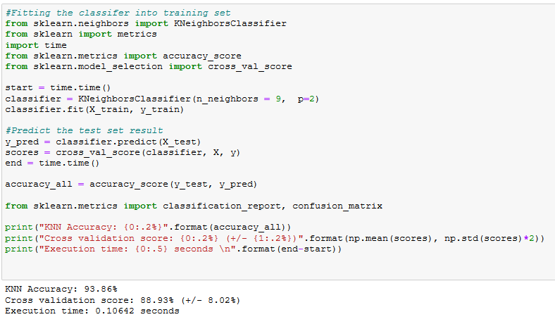
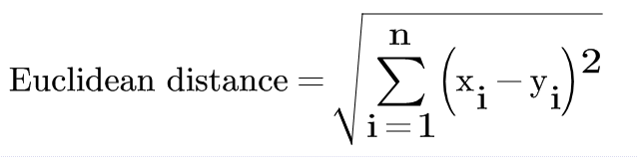
K-Nearest Neighbors Analysis
github.com/tamhuynh92/
Notes:
KNN is supervised machine learning algorithm whereas K-means is unsupervised machine learning algorithm
KNN is used for classification as well as regression whereas K-means is used for clustering
K in KNN is no. of nearest neighbors whereas K in K-means in the no. of clusters we are trying to identify in the data

Slide 23
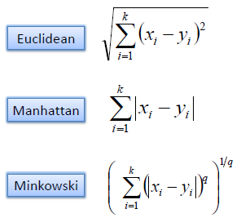
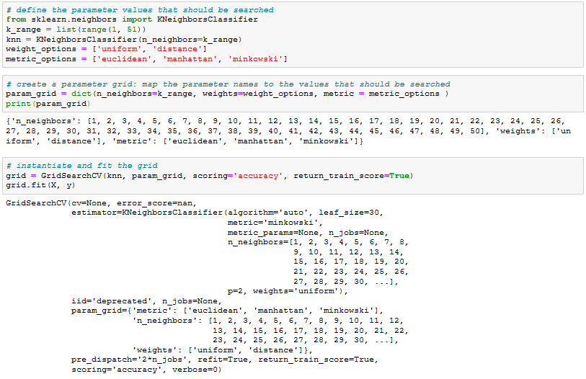
K-Nearest Neighbors Optimization
GridSearchCV
github.com/tamhuynh92/

Slide 24
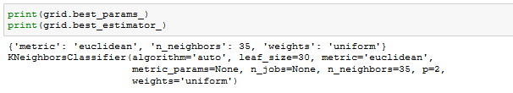
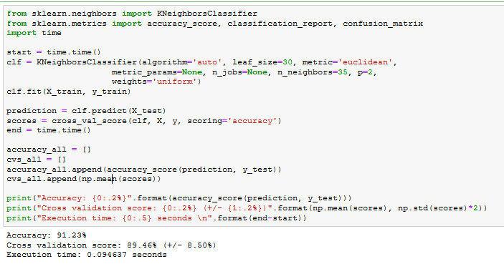
K-Nearest Neighbors Optimization
GridSearchCV
github.com/tamhuynh92/

Slide 25
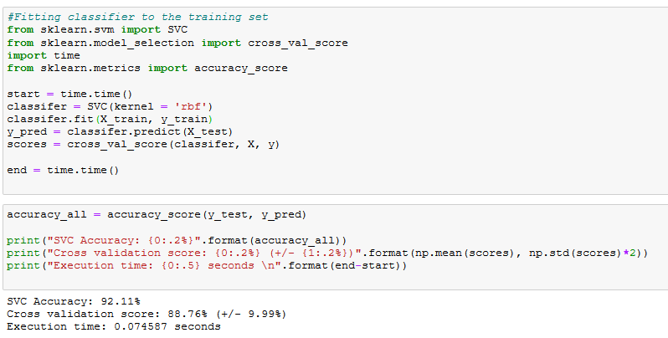
Support Vector Machine
github.com/tamhuynh92/
Notes:
https://www.datacamp.com/community/tutorials/svm-classification-scikit-learn-python
Tuning Hyperparameters
Kernel: The main function of the kernel is to transform the given dataset input data into the required form. There are various types of functions such as linear, polynomial, and radial basis function (RBF). Polynomial and RBF are useful for non-linear hyperplane. Polynomial and RBF kernels compute the separation line in the higher dimension. In some of the applications, it is suggested to use a more complex kernel to separate the classes that are curved or nonlinear. This transformation can lead to more accurate classifiers.
Regularization: Regularization parameter in python's Scikit-learn C parameter used to maintain regularization. Here C is the penalty parameter, which represents misclassification or error term. The misclassification or error term tells the SVM optimization how much error is bearable. This is how you can control the trade-off between decision boundary and misclassification term. A smaller value of C creates a small-margin hyperplane and a larger value of C creates a larger-margin hyperplane.
Gamma: A lower value of Gamma will loosely fit the training dataset, whereas a higher value of gamma will exactly fit the training dataset, which causes over-fitting. In other words, you can say a low value of gamma considers only nearby points in calculating the separation line, while the a value of gamma considers all the data points in the calculation of the separation line.
Advantages
SVM Classifiers offer good accuracy and perform faster prediction compared to Naïve Bayes algorithm. They also use less memory because they use a subset of training points in the decision phase. SVM works well with a clear margin of separation and with high dimensional space.
Disadvantages
SVM is not suitable for large datasets because of its high training time and it also takes more time in training compared to Naïve Bayes. It works poorly with overlapping classes and is also sensitive to the type of kernel used.
Advantages
High Dimensionality: SVM is an effective tool in high-dimensional spaces, which is particularly applicable to document classification and sentiment analysis where the dimensionality can be extremely large.
Memory Efficiency: Since only a subset of the training points are used in the actual decision process of assigning new members, just these points need to be stored in memory (and calculated upon) when making decisions.
Versatility: Class separation is often highly non-linear. The ability to apply new kernels allows substantial flexibility for the decision boundaries, leading to greater classification performance.
Disadvantages
Kernel Parameters Selection: SVMs are very sensitive to the choice of the kernel parameters. In situations where the number of features for each object exceeds the number of training data samples, SVMs can perform poorly. This can be seen intuitively as if the high-dimensional feature space is much larger than the samples. Then there are less effective support vectors on which to support the optimal linear hyperplanes, leading to poorer classification performance as new unseen samples are added.
Non-Probabilistic: Since the classifier works by placing objects above and below a classifying hyperplane, there is no direct probabilistic interpretation for group membership. However, one potential metric to determine the "effectiveness" of the classification is how far from the decision boundary the new point is.

Slide 26
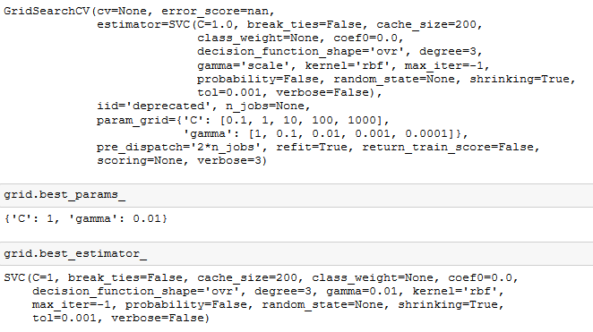
Support Vector Machine Optimization
github.com/tamhuynh92/

Slide 27
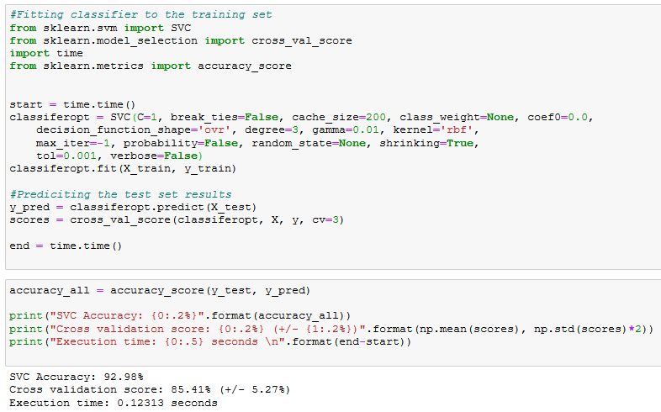
Support Vector Machine Optimization
github.com/tamhuynh92/

Slide 28
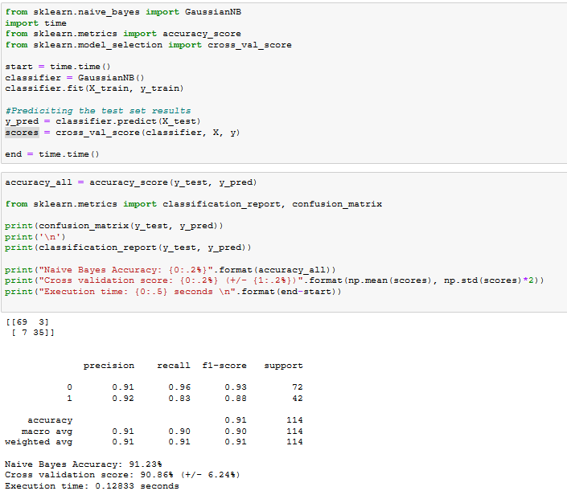
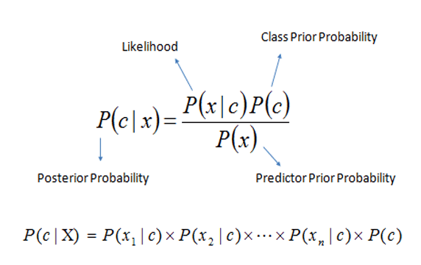
Naïve Bayes Analysis
github.com/tamhuynh92/
Notes:
Advantages
It is not only a simple approach but also a fast and accurate method for prediction.
Naive Bayes has very low computation cost.
It can efficiently work on a large dataset.
It performs well in case of discrete response variable compared to the continuous variable.
It can be used with multiple class prediction problems.
It also performs well in the case of text analytics problems.
When the assumption of independence holds, a Naive Bayes classifier performs better compared to other models like logistic regression.
Disadvantages
The assumption of independent features. In practice, it is almost impossible that model will get a set of predictors which are entirely independent.
If there is no training tuple of a particular class, this causes zero posterior probability. In this case, the model is unable to make predictions. This problem is known as Zero Probability/Frequency Problem. If a categorical variable has a category in test data set which was not observed in training data set, then the model will assign a zero probability. It will not be able to make a prediction. This is often known as “Zero Frequency”. To solve this, we can use the smoothing technique. One of the simplest smoothing techniques is called. Sklearn applies Laplace smoothing by default when you train a Naive Bayes classifier.
GaussianNB implements the Gaussian Naive Bayes algorithm for classification. The likelihood of the features is assumed to be Gaussian:
Multinomial: It is useful if your features are discrete. MultinomialNB implements the naive Bayes algorithm for multinomially distributed data, and is one of the two classic naive Bayes variants used in text classification (where the data are typically represented as word vector counts, although tf-idf vectors are also known to work well in practice).
Bernoulli: The binomial model is useful if your features are binary.
https://scikit-learn.org/stable/modules/naive_bayes.html

Slide 29
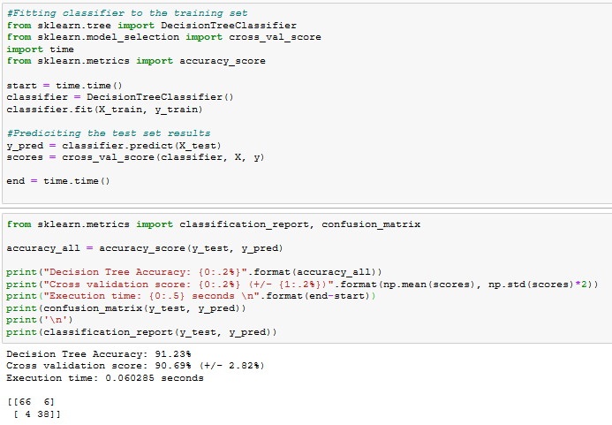
Decision Tree Analysis
github.com/tamhuynh92/

Slide 30
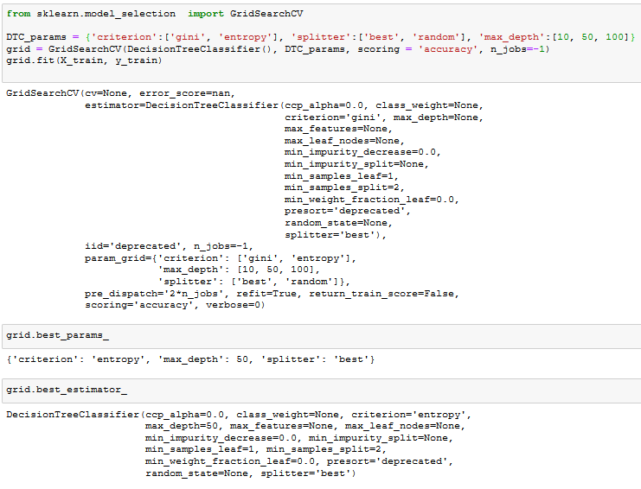
Decision Tree Optimization
github.com/tamhuynh92/

Slide 31
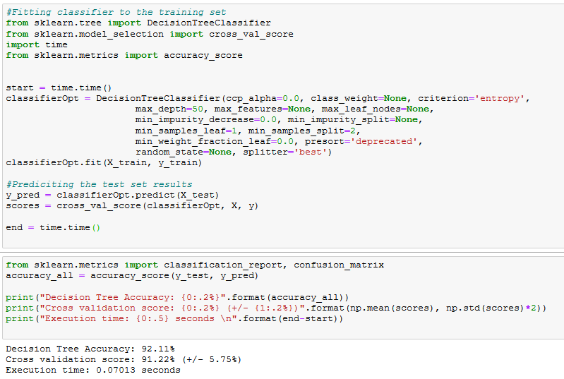
Decision Tree Optimization
github.com/tamhuynh92/

Slide 32
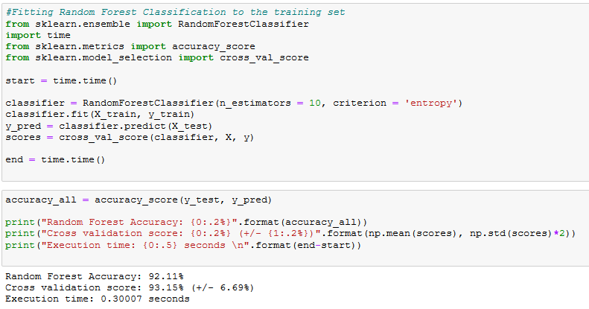
Random Forest Analysis
github.com/tamhuynh92/

Slide 33
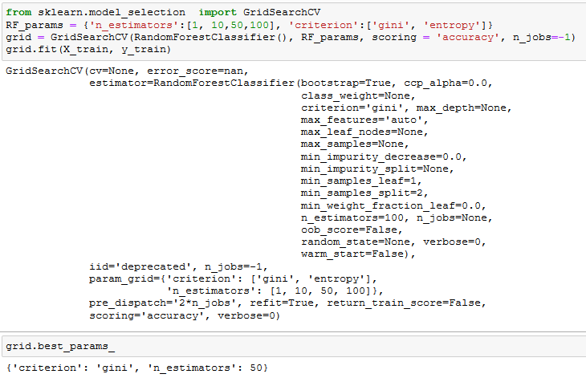
Random Forest Optimization
github.com/tamhuynh92/

Slide 34
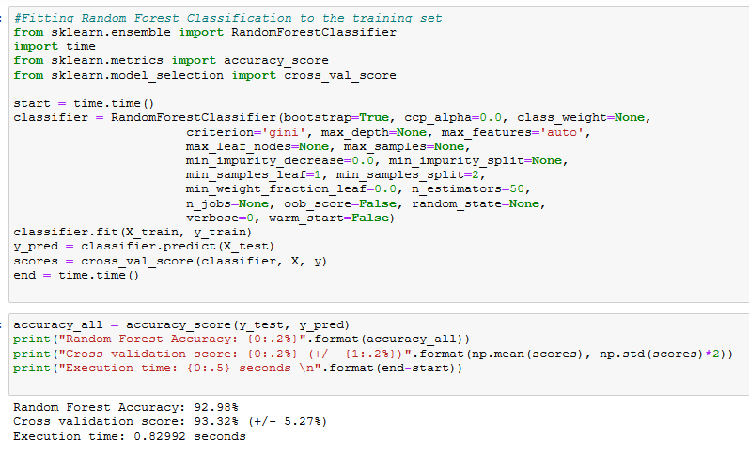
Random Forest Optimization
github.com/tamhuynh92/

Slide 35
Overall Summary
 | Accuracy (%) | Cross Validation (%) | St. Dev (%) | Time (s)
Logistic Regression | 94.74 | 93.19 | 2.56 | 0.176
K-NN | 91.23 | 89.46 | 8.50 | 0.095
SVM | 92.98 | 85.41 | 5.27 | 0.123
Naïve Bayes | 91.23 | 90.86 | 6.24 | 0.128
Decision Tree | 92.11 | 91.22 | 5.75 | 0.070
Random Forest | 92.98 | 93.32 | 5.27 | 0.830
github.com/tamhuynh92/

Slide 36
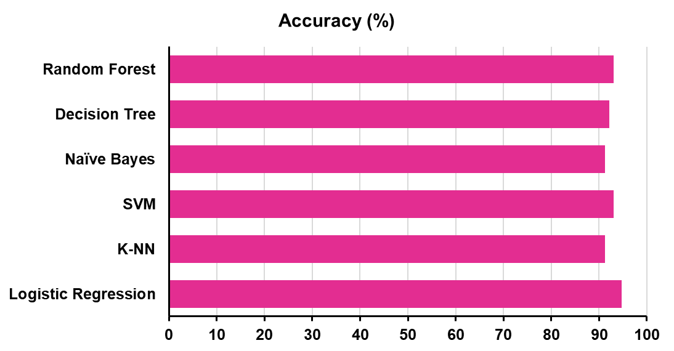
Accuracy Comparison
github.com/tamhuynh92/

Slide 37
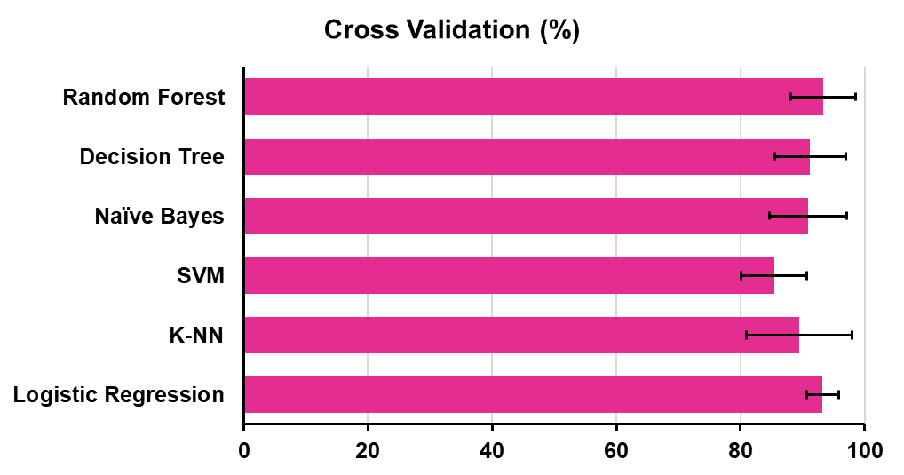
Cross Validation Comparison
github.com/tamhuynh92/

Slide 38
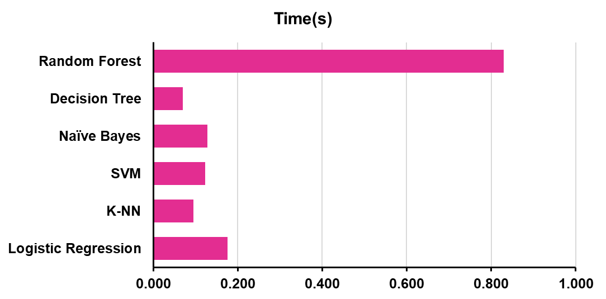
Running Time Comparison
github.com/tamhuynh92/

Slide 39
Thank You !
github.com/tamhuynh92/
Edit your company slogan

